Slide 1
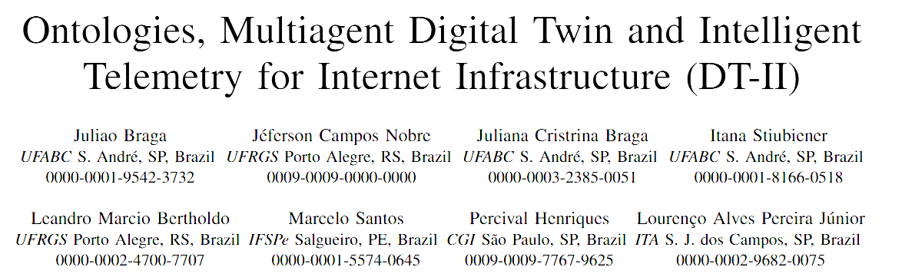

IFSPe (PE), ITA (SP), UFABC (SP), UFRGS(RS), and UNICAP (PE)

Slide 2
Knowledge Base (Ontology)
The
Knowledge
Base
2
IFSPe, ITA, UFABC, UFRGS, UNICAP

Slide 3
Knowledge Base (Ontology)
The
Knowledge
Base
3
IFSPe, ITA, UFABC, UFRGS, UNICAP

Slide 4
Knowledge Base (Ontology)
Description Logic (OWL)
The
Knowledge
Base
4
IFSPe, ITA, UFABC, UFRGS, UNICAP

Slide 5
Knowledge Base (Ontology)
Description Logic (OWL)
TBox
ABox
RBox
Terminological Box
Assertion Box
Role Box
The
Knowledge
Base
5
IFSPe, ITA, UFABC, UFRGS, UNICAP

Slide 6
Knowledge Base (Ontology)
Description Logic (OWL)
TBox
ABox
RBox
Terminological Box
Assertion Box
Role Box
The
Knowledge
Base
Concept Definitions
Facts about individuals
Relationship Rules
Person ⊑ Mammal⁽¹⁾
Car ⊑ Vehicle⁽²⁾
Driver ≡ Person who drives a vehicle
Mary is a Person
Fiat is a Car
Mary drivex Fiat
drives ⊑ interactsWith⁽³⁾
hasFather ⊑ hasParent
hasBrother is symmetric⁽⁴⁾
married is functional⁽⁵⁾
Every person is a mammal
Every car is a vehicle
Driving is a type of interaction
If A is B's brother, then B is A's brother
Each person is married to at most one other person
6
IFSPe, ITA, UFABC, UFRGS, UNICAP

Slide 7
Knowledge Base (Ontology)
Description Logic (OWL)
TBox
ABox
RBox
Terminological Box
Assertion Box
Role Box
The
Knowledge
Base
Concept Definitions
Facts about individuals
Relationship Rules
Person ⊑ Mammal⁽¹⁾
Car ⊑ Vehicle⁽²⁾
Driver ≡ Person who drives a vehicle
Mary is a Person
Fiat is a Car
Mary drivex Fiat
drives ⊑ interactsWith⁽³⁾
hasFather ⊑ hasParent
hasBrother is symmetric⁽⁴⁾
married is functional⁽⁵⁾
Reasoner (Inference)
Every person is a mammal
Every car is a vehicle
Driving is a type of interaction
If A is B's brother, then B is A's brother
Each person is married to at most one other person
Mary is a Mammal
7
IFSPe, ITA, UFABC, UFRGS, UNICAP

Slide 8
Upper Ontology: highly general and domain-independent concepts, including object, event, process, quality, time, and space. Examples include BFO, DOLCE, UFO, SUMO, and GFO.
Domain Ontology: concepts of a specific area.
UFO in the Development of Domain Ontologies
Advantages | In the Generic Domain | In the Information Infrastructure Domain
Distinguishing what something is from the role it plays | A person remains a person throughout their life, but is a student only for a period, while enrolled. It may seem obvious, yet information systems often confuse this distinction. UFO enforces the need to make it explicit. | A network is an Autonomous System, but simultaneously acts as a provider to one neighbour and as a client to another. Without this separation, the model fails as soon as the same network assumes two roles.
Being able to state when something continues to be "the same" | A football team replaces all its players over the years and yet remains the same team. UFO requires one to explicitly state what ensures this continuity. | An AS replaces routers, cables, and addresses, yet remains the same AS. What sustains it is the official registry that created it, not the number nor the equipment.
Treating agreements and relations as "real things" | A marriage is not merely a line connecting two people. It has a start date, rules, and may end. UFO treats such relations as entities in their own right, called relators. | A traffic exchange agreement between two networks has a beginning, conditions, and an end. Modelled in this way, the system can answer since when have these networks been partners?
Providing a common foundation that enables interoperability with other models | If two cities use the same socket standard, any appliance works in both. Ontologies built upon UFO share the same conceptual "socket standard", thus fitting together with less effort. | An AS ontology based on UFO can be linked to existing ontologies of contracts, services, or risks, rather than starting entirely from scratch.
Types of
Ontologies
UFO entails higher initial costs, yet prevents costly errors along the way. It proves worthwhile when the domain is complex, involves relations and agreements, and when the model must endure and integrate with others, as is the case
8
IFSPe, ITA, UFABC, UFRGS, UNICAP

Slide 9
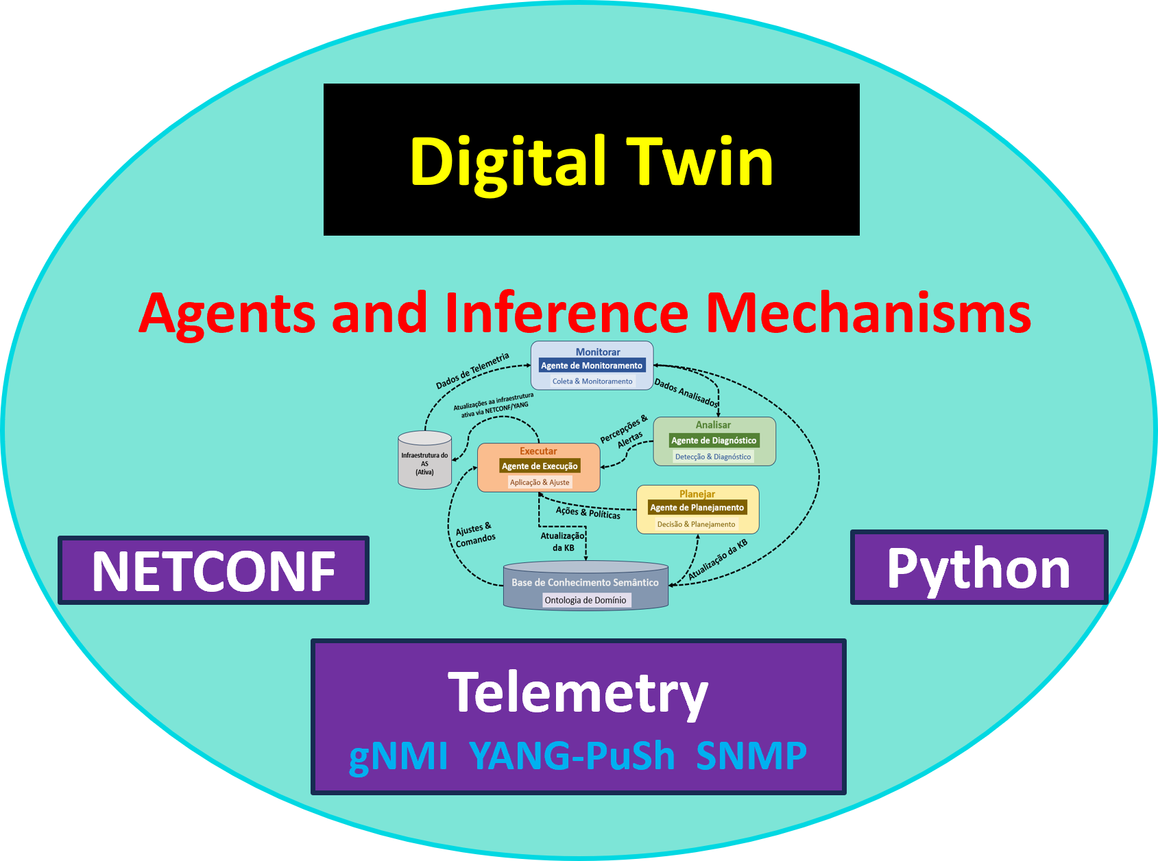
The
Project
9
IFSPe, ITA, UFABC, UFRGS, UNICAP

Slide 10
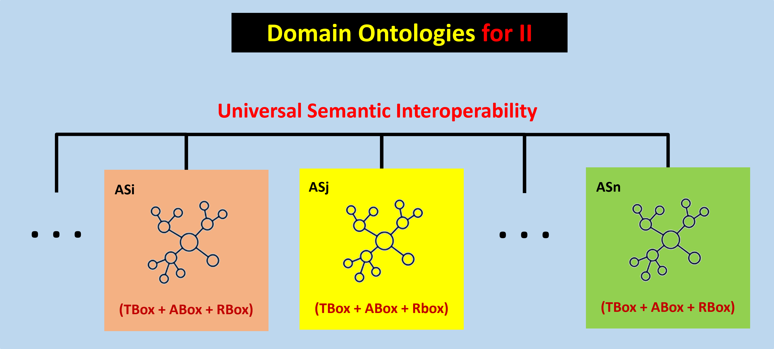
The
Project
10
IFSPe, ITA, UFABC, UFRGS, UNICAP

Slide 11
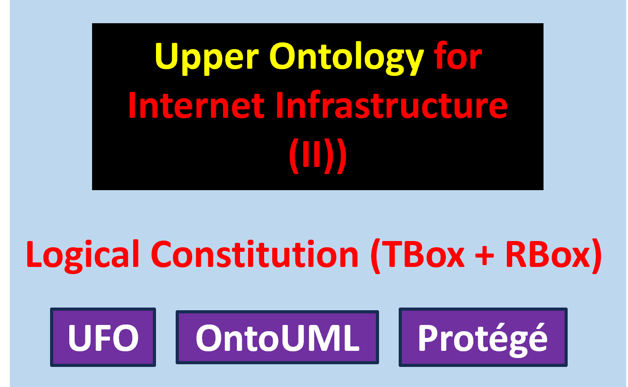
The
Project
11
IFSPe, ITA, UFABC, UFRGS, UNICAP

Slide 12
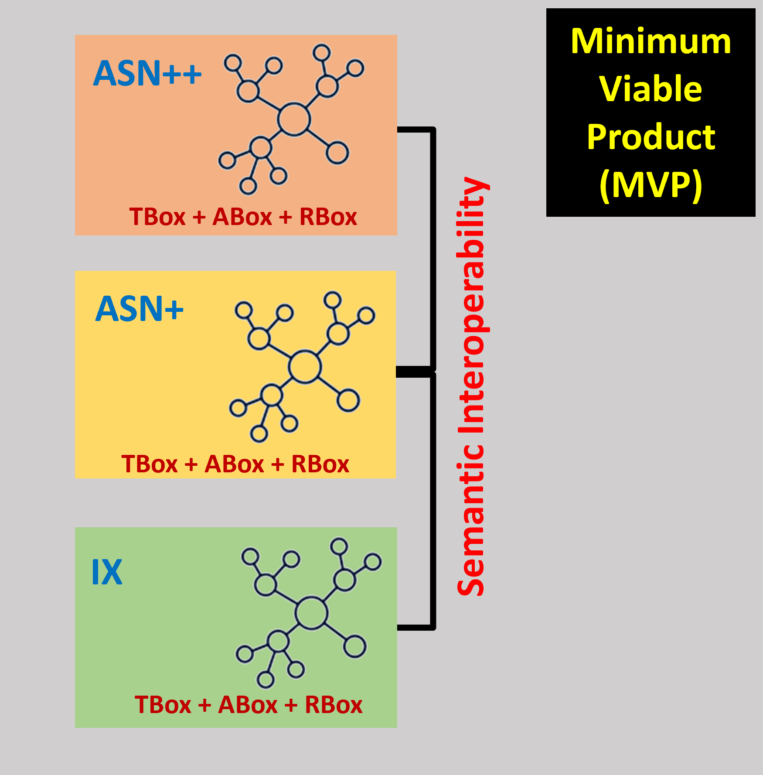
The
Project
12
IFSPe, ITA, UFABC, UFRGS, UNICAP

Slide 13

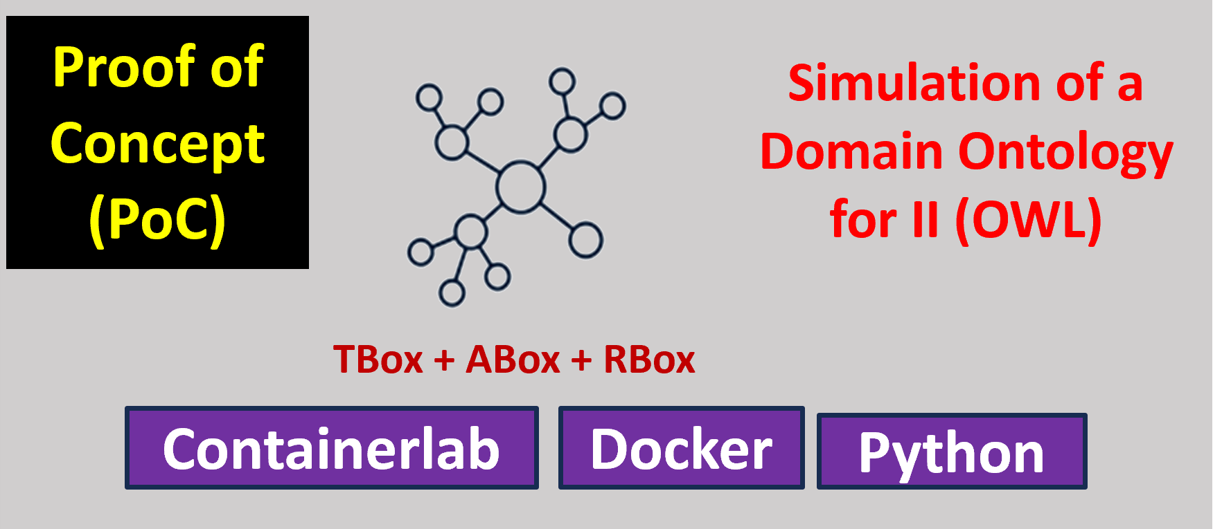
The
Project
13
IFSPe, ITA, UFABC, UFRGS, UNICAP

Slide 14
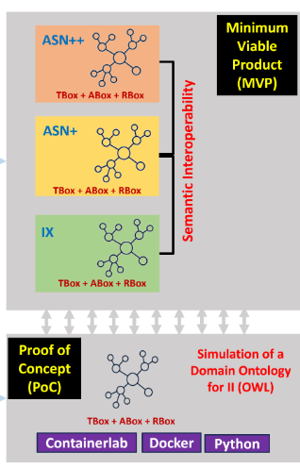
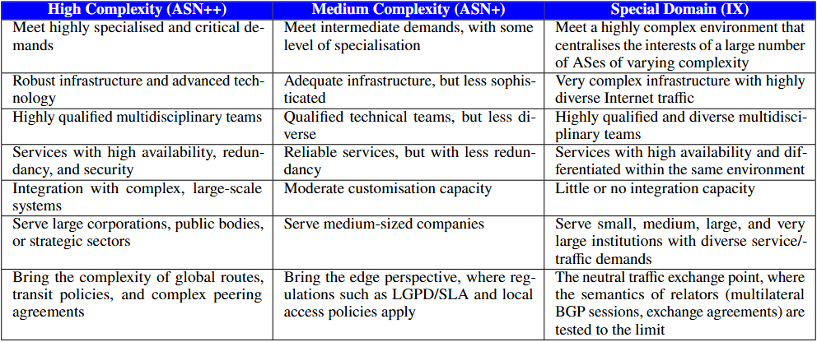
14
IFSPe, ITA, UFABC, UFRGS, UNICAP

Slide 15
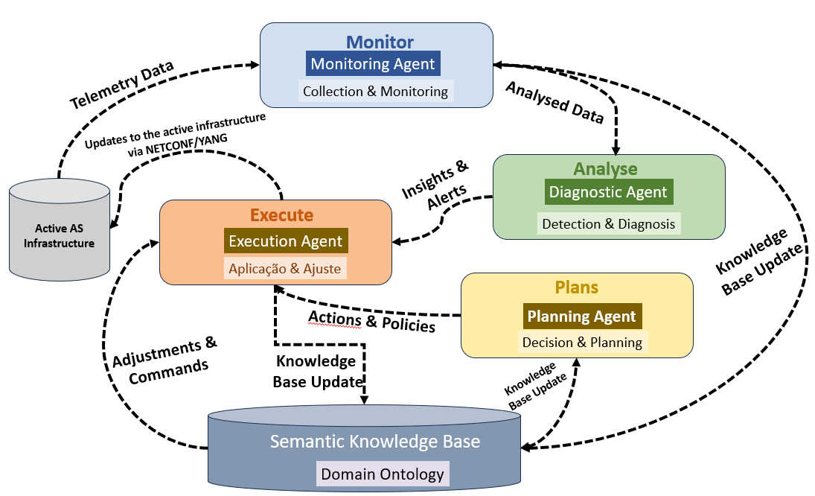
MAPE-K
Jeffrey O. Kephart and David M. Chess. “The Vision of Autonomic Computing”. In: Computer. Vol. 36. 1. IEEE,2003, pp. 41–50. doi: 10.1109/MCOM.2003.1160055
15
IFSPe, ITA, UFABC, UFRGS, UNICAP

Slide 16
Ontological Layer
Tbox: define core classes (NetworkNode, Connection, Channel) and constraints
Identity Layer
Assigns stable IRIs to instances, separating identity from state
Ingestion Layer
Collects telemetry (YANG-Push, gNMI, SNMP, syslog) and normalises data into the Node–Connection–Channel triad
DT Reference
Architecture
Persistence Layer
ABox + Rbox: stores facts in RDF/OWL and maintains temporal history via observations
Validation Layer
Applies structural constraints and logical consistency checks with DL and DeL reasoners
Reasoning Layer
Infers states and propagates failures
Exposure Layer
Provides SPARQL queries, dashboards, alerts, and integration with NOC/orchestration systems
16
IFSPe, ITA, UFABC, UFRGS, UNICAP

Slide 17
Meaning-Driven Regulatory Compliance
Jurisdiction is no longer a property of hardware but a normative relationship (a relator) linking a norm, the parties and the network resources.
SCENARIO
Hospital
São Paulo
AS-A
Brazil
AS-B
International transit
AS-C
Europe
Analysis service
Europe
Use
Case
(I)
Rule (LGPD + GDPR): health data may only traverse adequately protected jurisdictions.
T
TBox
General rules
R
RBox
How relations propagate
A
ABox
Facts of the moment
Health-data flows only traverse adequately protected jurisdictions.
If a node is subject to the LGPD, so are the channels and connections passing through it.
Flow F carries health data · F passes through node N3 · N3 is under jurisdiction J.
17
IFSPe, ITA, UFABC, UFRGS, UNICAP
Notes:
Core idea: compliance follows meaning, not geography. Walk the audience along the path: a hospital in São Paulo sends health data to Europe through three Autonomous Systems. The rule comes from LGPD and GDPR. The knowledge base has three parts: TBox holds the rules, RBox says how obligations propagate along relations, ABox holds the current facts fed by the Digital Twin.
Ideia central: a conformidade segue o significado, não a geografia. Vamos acompanhar o percurso: um hospital em São Paulo envia dados de saúde para a Europa por meio de três Sistemas Autônomos. A regra deriva da LGPD e do GDPR. A base de conhecimento é composta por três partes: a TBox contém as regras; a RBox define como as obrigações se propagam ao longo das relações; e a ABox armazena os fatos atuais, alimentados pelo Gêmeo Digital (Digital Twin).

Slide 18
The Digital Twin in Action (Use Case I)
Telemetry
gNMI · YANG-Push · SNMP
Semantic Elevation
raw data → meaning
ABox
facts with meaning
Reasoner
checks the rules
MAPE-K LOOP AFTER A BGP FAILURE
M
Monitor: Flow F has changed route.
M
Use
Case
(I)
Knowledge
(ontology)
A
Analyse: F now traverses a non-compliant jurisdiction.
E
A
P
Plan: A compliant alternative via AS-D is found.
P
E
Execute: Applied via NETCONF, only after logical validation.
Takeaway: the network becomes jurisdiction-aware; compliance is checked by logical inference, not manual audits.
18
IFSPe, ITA, UFABC, UFRGS, UNICAP
Notes:
Top row: how raw telemetry becomes meaning. Semantic Elevation turns gNMI, YANG-Push and SNMP data into ABox facts the reasoner can use. Bottom: a BGP failure diverts flow F. Monitor sees the new route; Analyse finds the violation; Plan finds a compliant route via AS-D; Execute pushes it with NETCONF only after the reasoner confirms it satisfies the rules. All four stages share the ontology as their knowledge base.
Linha superior: como a telemetria bruta se transforma em significado. A "Elevação Semântica" (Semantic Elevation) converte dados de gNMI, YANG-Push e SNMP em fatos ABox que o mecanismo de raciocínio (reasoner) pode utilizar. Parte inferior: uma falha no BGP desvia o fluxo F. O monitor detecta a nova rota; o módulo de análise identifica a violação; o módulo de planejamento encontra uma rota em conformidade via AS-D; o módulo de execução aplica essa rota via NETCONF, mas apenas após o mecanismo de raciocínio confirmar que ela atende às regras. As quatro etapas compartilham a ontologia como sua base de conhecimento.

Slide 19
Responding to a DDoS Attack
Conventional defences react to the symptom (suspicious IPs). DT-II reacts to the meaning: which services depend on what, and which agreements apply.
SCENARIO
External botnet
attack source
Link_01
1 → 100 Gbps · saturated
DNS service
critical
Users
everything else depends on DNS
THE MAPE-K RESPONSE
Use
Case
(II)
M
Monitor
Steps 1–2
A
Analyse
Steps 3–4
P
Plan
Step 5
E
Execute
Steps 6–8
Telemetry becomes ABox facts: the flow is anomalous, Link_01 is saturated.
The reasoner infers that DNS is at risk and identifies the source AS and its agreement.
TBox rule: critical service at risk + external source → mitigate at the edge.
Filter applied via NETCONF, confirmed, and the ABox updated to “protected”.
19
IFSPe, ITA, UFABC, UFRGS, UNICAP
Notes:
A botnet floods the edge link Link_01, which carries the critical DNS service. Walk through the MAPE-K loop: Monitor turns telemetry into facts; Analyse uses the RBox to infer that DNS is at risk, without anyone stating it; Plan applies a TBox rule that prescribes edge mitigation; Execute pushes a filter via NETCONF and records the new state, closing the loop. The step numbers refer to the sequence diagram on the next slide.
Uma botnet sobrecarrega o enlace de borda Link_01, que transporta o serviço crítico de DNS. Vamos percorrer o ciclo MAPE-K: a etapa Monitor transforma telemetria em fatos; a etapa Analyse utiliza a RBox para inferir que o DNS está em risco, sem que isso precise ser declarado explicitamente; a etapa Plan aplica uma regra da TBox que prescreve uma mitigação na borda; a etapa Execute implementa um filtro via NETCONF e registra o novo estado, fechando o ciclo. A numeração das etapas refere-se ao diagrama de sequência no próximo slide.

Slide 20
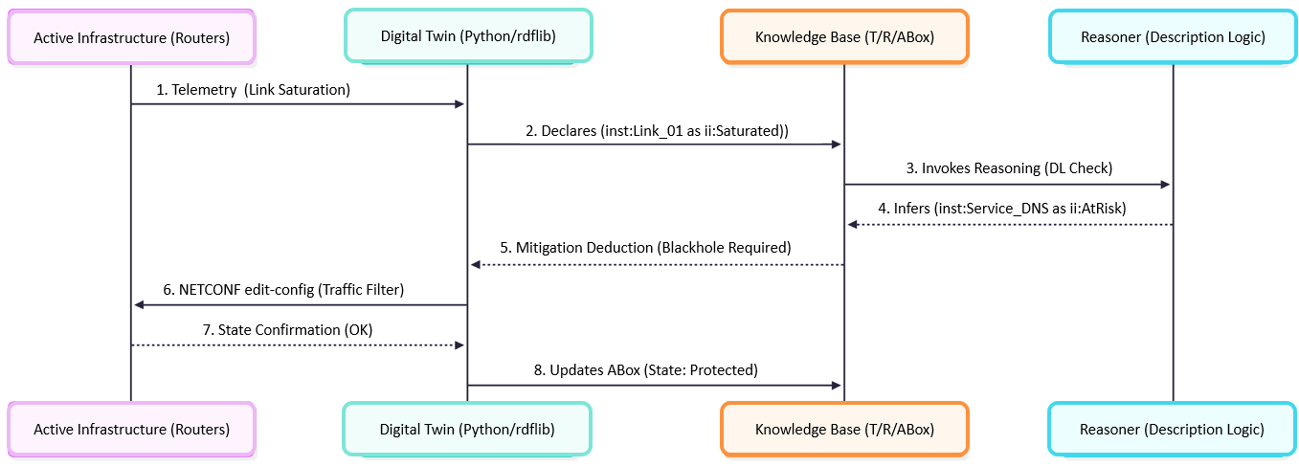
Sequence Flow of the Mitigation
Use
Case
(II)
Monitor Steps 1–2
Analyse Steps 3–4
Plan Step 5
Execute Steps 6–8
20
IFSPe, ITA, UFABC, UFRGS, UNICAP
Notes:
Each numbered arrow belongs to one MAPE-K stage, shown in the coloured chips below. The whole loop runs without human intervention; the decision is made in the logical core and only then turned into a router configuration.

Slide 21
Why a Semantic Defence?
HOW THE REASONER INFERS THE RISK
ADVANTAGES OVER IP BLOCKING
Flow
anomalous
saturates
Link_01
edge link
supports
DNS
critical service
1
Context awareness
2
Mereological resilience
If the source AS has a cooperation agreement, ask it to filter at source instead of just blocking.
The model knows the parts of the network and their roles: sacrifice non-vital channels, keep DNS.
inferred: threatens
saturates ∘ supports ⊑ threatens
If a flow saturates a link and the link supports a service, the flow threatens the service. Nobody declares that DNS is at risk: the reasoner concludes it.
3
Traceability
4
Compliance
Use
Case
(II)
Every action is explained by the axioms that justified it.
No configuration is applied before it is validated against the compliance regime (Use Case I).
Takeaway: the defence knows what is at stake and why it acts, not just which IPs to block.
21
IFSPe, ITA, UFABC, UFRGS, UNICAP
Notes:
Left: the RBox property chain in action. Saturates followed by supports implies threatens, so the reasoner infers that DNS is at risk. Right: four advantages over plain IP blocking. Context awareness uses agreements modelled as relators; mereological resilience uses the part-whole structure of the network; traceability comes from the axioms; compliance links back to Use Case I.

Slide 22
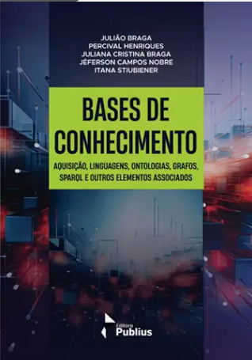
an ontology-driven reference model for II centred on Node–Connection–Channel, grounded in UFO and developed in OntoUML;
an operationalisation in DL/OWL supporting automated reasoning over TBox, ABox, and RBox;
a synchronisation approach aligning the KG with model-driven telemetry (e.g., YANG-Push) for near real-timestate updates;
a governance mechanism based on an Ontological Compliance Regime and SLA constraints, enabling auditable and explainable compliance checks;
a multi-agent Digital Twin architecture following the MAPE-K cycle for policy-driven actions;
Second edition of the book Knowledge Bases, including an English language version. It incorporates knowledge gained through the research project.
Contributions
IFSPe, ITA, UFABC, UFRGS, UNICAP

Slide 23
Project
Documentation
Project Digital Twin for Internet Infrastructure
Main: https://github.com/LJuliaoBraga/dtii
English: https://github.com/LJuliaoBraga/dtii/blob/main/docs/en-us/2026-ProjectDT-II-EN.pdf
Portuguese: https://github.com/LJuliaoBraga/dtii/blob/main/docs/pt-br/2026-ProjectDT-II-PT.pdf
ANMS 2006: https://github.com/LJuliaoBraga/dtii/blob/main/docs/events/anms%202026/2027_anms.pdf
23
IFSPe, ITA, UFABC, UFRGS, UNICAP

Slide 24
Thank you
24
IFSPe, ITA, UFABC, UFRGS, UNICAP

